Slide 1
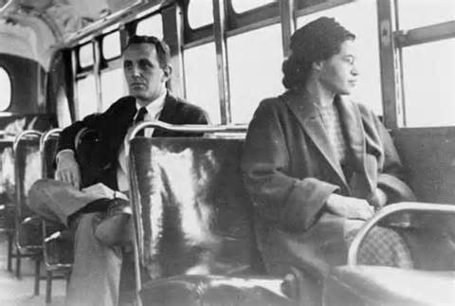
The Movement Begins
Ch. 24.1

Slide 2
Objectives
Explain the origin of the Southern Christian Leadership Conference
Discuss the changing role of the federal government in civil rights enforcement

Slide 3
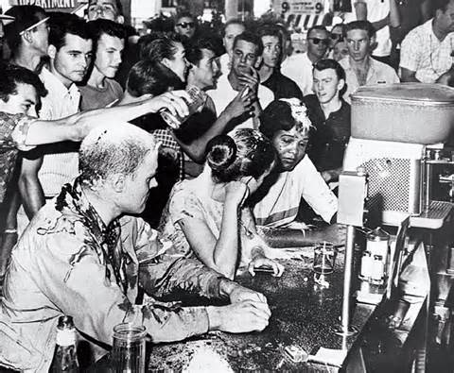
Origins of the Movement
I. Origins
A. Court Challenges
1. NAACP (1909)
a. Norris v. Alabama
b. Morgan v. Virginia
c. Sweatt v. Painter
B. Push for Desegregation
1. Congress of Racial Equality
a. sit-ins

Slide 4
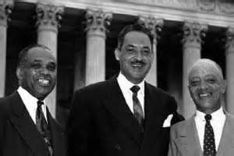
Civil Rights Movement Begins
II. Beginning of Movement
A. Brown v. Board of Education
1. Thurgood Marshall
B. Southern Manifesto
1. Massive Resistance
a. pupil assignment laws
C. Montgomery Bus Boycott
1. Montgomery Improvement Association
a. Martin Luther King

Slide 5
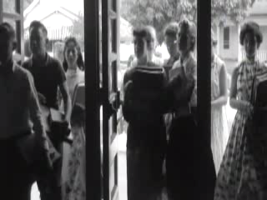
Crisis in Little Rock

Slide 6
Homework
Pg. 752 #’s 1-4

