Slide 1
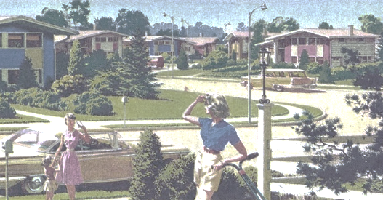
1950’s Society: Internal Migration and Immigration

Slide 2
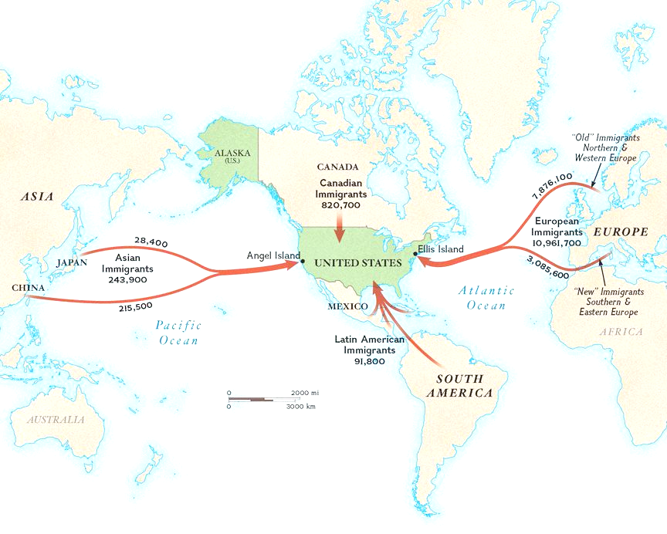
What were the various pull factors for immigration to the United States during the industrial revolution time period? What effect did these ethnic groups have on the composition of major cities (socially, economically, politically)?

Slide 3
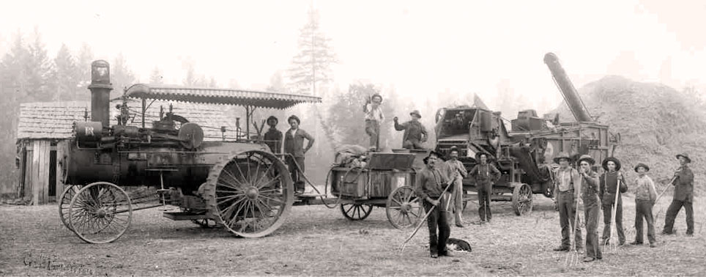
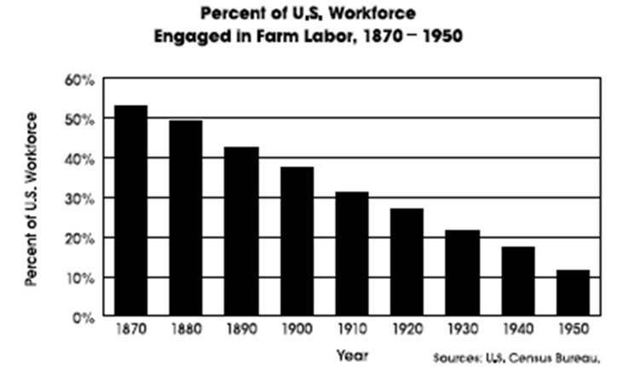
What caused rural to urban shifts during the late 1800's and early 1900's?

Slide 4
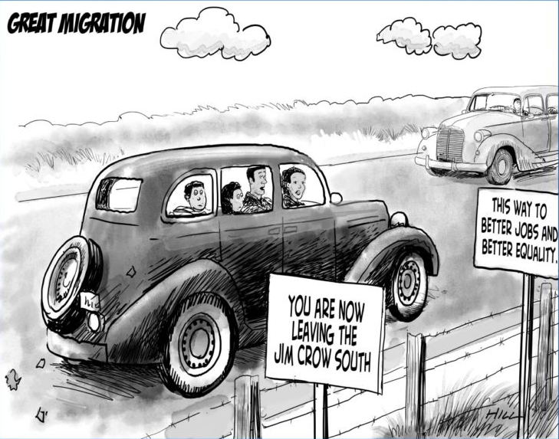
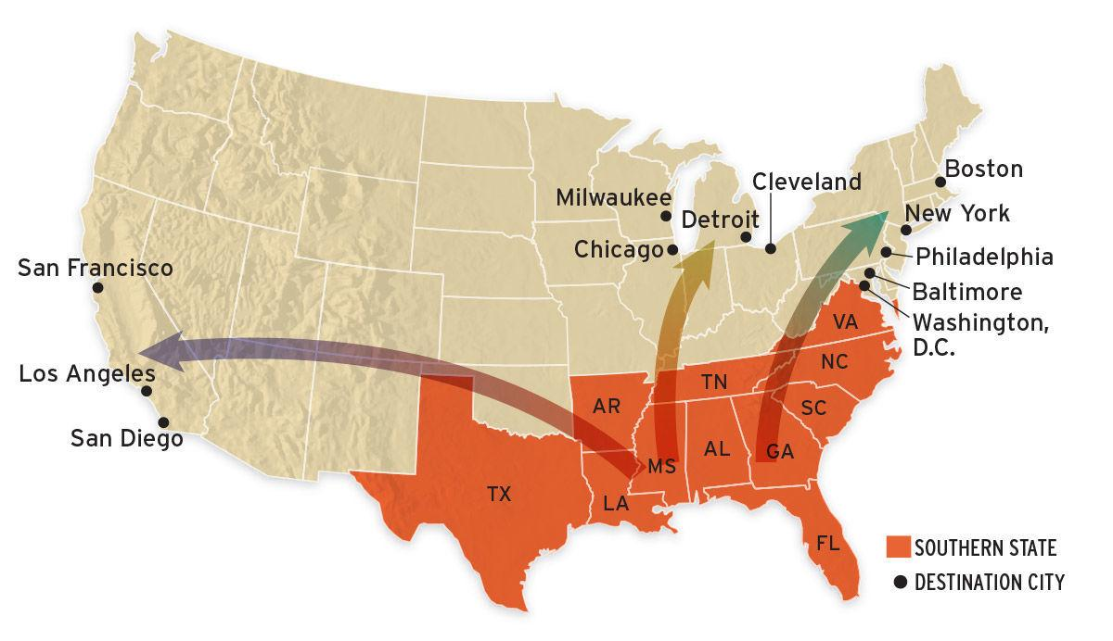
What caused large numbers of African Americans to migrate within the United States during the early to mid 20'th century (1900's)?

Slide 5
Into the 1950’s and beyond
From the 1880's through the 1940's we've primarily witnessed urban expansion in the U.S., but if we look locally, regionally, and nationally, do Americans live within cities today, or just outside of them?
When did this shift from urban to suburban occur?
How has this shift continued to affect the U.S. socially, politically, and economically?
What other areas around the United States have we seen grow and expand as a result of these shifts?

Slide 6
Exploratory Learning Activity
https://www.preisse.weebly.com
You will need to create a google doc to answer the various questions pertaining to historically significant population shifts and be able to submit them to Mr. Wallace

