Slide 1
Warm Up
What do you notice about the homes in this photograph?
What is similar and dissimilar about this neighborhood to your own?
What does this neighborhood say about the 1950s?
Does Levittown represent the ideal neighborhood of the 1950s? Why or why not?

Slide 2
Post-War America
1946 - 1960

Slide 4
 | 1940 | 1947 | 1949 | 1951 | 1953 | 1955 | 1957
Life expectancy | 62.9 | 66.8 | 68 | 68.4 | 68.8 | 69.6 | 69.6
GNP per capita | 754 | 1,605 | 1,719 | 2,129 | 2,286 | 2,408 | 2,576
Avg. income (full time) | 1,299 | 2,589 | 3,217 | 3,581 | 3,851 | 4,230 | 4594
Avg. income of a rail worker | 1,906 | 3,211 | 3,703 | 4,161 | 4,415 | 4,697 | 5,416
Avg. income of a dentist | 3,281 | 6,610 | 7,146 | 7,820 | 10,873 | 12,480 | 14,311
Avg. income of a nurse | 927 | 1,821 | 1,912 | 2,099 | 2,335 | 2,497 | 2,660
1lb. of bread | .08 | .12 | .14 | .16 | .16 | .18 | .19
1lb. of steak | .36 | .76 | .85 | .1.09 | .92 | .90 | .94
% of Unemployed | 14.6 | 3.9 | 5.9 | 3.3 | 2.9 | 4.4 | 4.3
% of families w/ automobiles | -- | -- | 56% | 60% | 61% | 70% | 75%

Slide 5
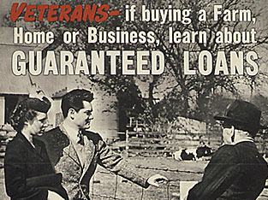
Truman: Domestic Issues
“Fair Deal” proposals
Expansion of Social Security
Raise minimum wage
Universal Healthcare
Fair Employment Practices Act (FEPA)*
National Housing Act: Public housing
“Reconversion” to peace time economy
Americans had savings from WWII
GI Bill of Rights
College/Business Loan/Home Loan
“White Flight” to Suburbs
Minorities & women replaced, but most wanted to keep working

Slide 6
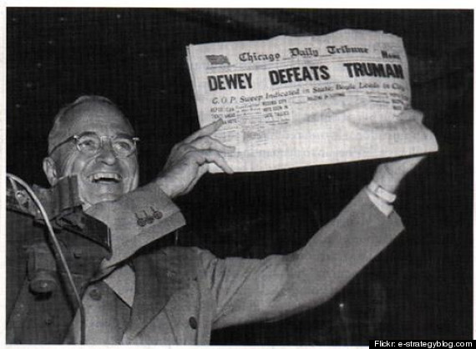
Dixiecrats & the 1948 election
1948 Democratic Party Platform
Truman integrate armed forces months before: Executive Order 9981
Truman insists on Civil Rights plank, too
Democrats split
Third Party created
Dixiecrats –southern whites
Strom Thurmond (South Carolina) presidential candidate
Truman still defeats republican Thomas Dewey (NY)

Slide 7
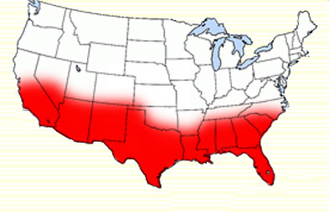
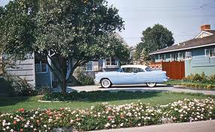
Causes & Effects of Post-WWII Consumerism
Economic boom of the 1950s was 250% more than the 20’s
More even distribution (wages triple)
Gov’t spending in schools, housing, veterans’ benefits
Low inflation 3% annually
Low unemployment less than 5%
Nations population rose 20% from births ‘baby boom’
Rise of the Sunbelt
Military bases
Oil production
Western state universities & research facilities
Suburban living
Surge in automobile ownership
No competition outside of US
home (new production) purchases

Slide 8
The Suburban Nation
Suburbs
Levittown –working class homes
white flight; minority population from WWII remains in Northern cities
Car Culture
Leisure time: Drive-ins, family vacations
Garages, parking lots
Fast Food
Consumer Culture
Improved appliances & leisure time devices
Nuclear family – “return to conformity”
Highly structured, rules-based society
Gender roles reinforced
dad’s sphere –work
mom’s sphere –home
Dr. Benjamin Spock –purpose of motherhood was to raise & teach children (parallel's REPUBLICAN MOTHERHOOD)
Child-centered:
child’s needs come first
Not wage earners
Mass media (Television)
Ideal American family, -white, middle-class, suburban

Slide 9
The Other America
Socialist writer Michael Harrington’s ‘The Other America’
In 1960, at least 1/5th of all families lived in poverty (30 mil)
20% of this group lived in persistent poverty
Rise of inner-city “ghettos”
Unskilled industrial jobs begin declining in the 1950s
Created a “culture of poverty” w/white flight
Black Urban migration continues 1940-1960
Northern manufacturing jobs in WWII
Result of mechanization of cotton harvesting –sharecropping ends

Slide 10
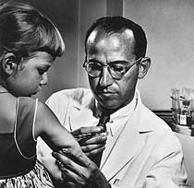
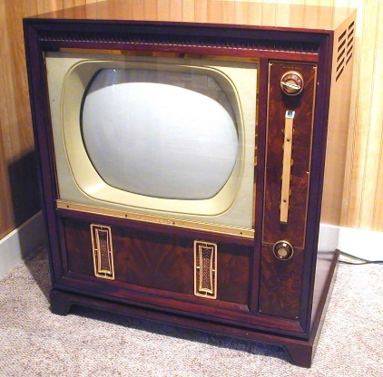
Expansion of Science & Technology
Medical Breakthroughs
Penicillin & other Antibiotics
Nearly eradicates tuberculosis in the US
Salk Vaccine for Polio
Pesticides
DDT –controls insect-borne diseases, but long term toxic affect on people & animals
Electronics
Transistors –miniaturization of electronics
Television –mass produced, affordable

Slide 11
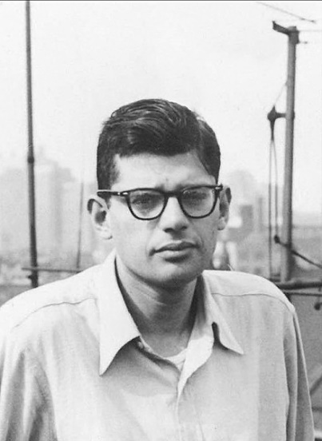
Reaction
Decline of the efficacy of values like restraint & thrift https://www.youtube.com/watch?v=CrYX9j3Tqzw
Rebellion to adult authority
Beat generation (beatniks) –criticized the sterility of middle class
Allen Ginsberg’s, “Howl”
Conformity creates madness, lack of purpose: non-conformity creates dislocation from society
Jack Kerouac’s On the Road (1957)
Road trip, glorification of rootlessness & drug usage
Rock n’ Roll –’the negro sound’
Drew heavily from black rhythm & blues music
Music producers wanted white artists who would be able to play to white audiences
Bill Haley’s Rock Around the Clock (1955)
Buddy Holly (1955)
Elvis Pressley (1956)

Slide 12
Close: True or False
1920s and 1950s were similar in that they were times of increased economic prosperity for individuals at every income level.
The Red Scare of the 1950’s was based Soviet influence of US government officials, while that of the 1920’s was anti-immigrant in sentiment.
The youth music of the 1950s was like that of the 1920s in that is had roots in African-American style & rhythms.

