Slide 1
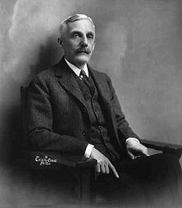
Roaring 20’s: Policies of Prosperity

Slide 2
Objectives
Explain Andrew Mellon’s economic strategies for maintaining prosperity.
Describe how the United States remained involved in world affairs without joining the League of Nations.

Slide 3
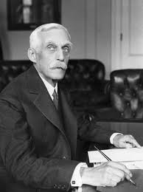
Promoting Prosperity
I. Promoting Prosperity
A. Andrew Mellon
1. Secretary of Treasury (1920)
B. Mellon’s Program
1. Gov. apply business principles
ex: Budget & Accounting Office
2. 3 Main Goals:
-balance the budget
-reduce the debt
-cut taxes

Slide 4
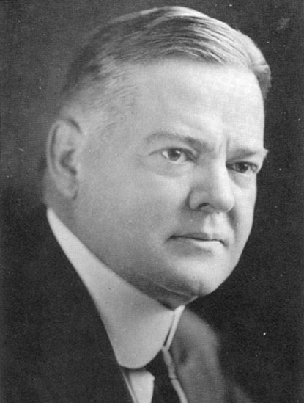
Supply-Side Economics
3. Supply-Side Economics
TAXES = Collectable $
C. Cooperative Individualism
1. Businesses input strategies on
economic improvement
II. Trade & Arms Control
A. Isolationism
1. operate outside of League of Nat’s

Slide 5
Dawes Plan
B. Dawes Plan
1. Charles G. Dawes
a. U.S. Banks loan $ to Germany
b. France & GB reparations
c. France & GB pay war debt to U.S.
C. Washington Conference
1. moratorium “paused” construction of Navy
a. 3 Agreements:
-5Power Naval Limitation Treaty, 4Power Treaty, 9 Power Treaty

Slide 6
Homework
Review the Study Guide at the bottom of module #8 – “Roaring Twenties”

